Slide 1
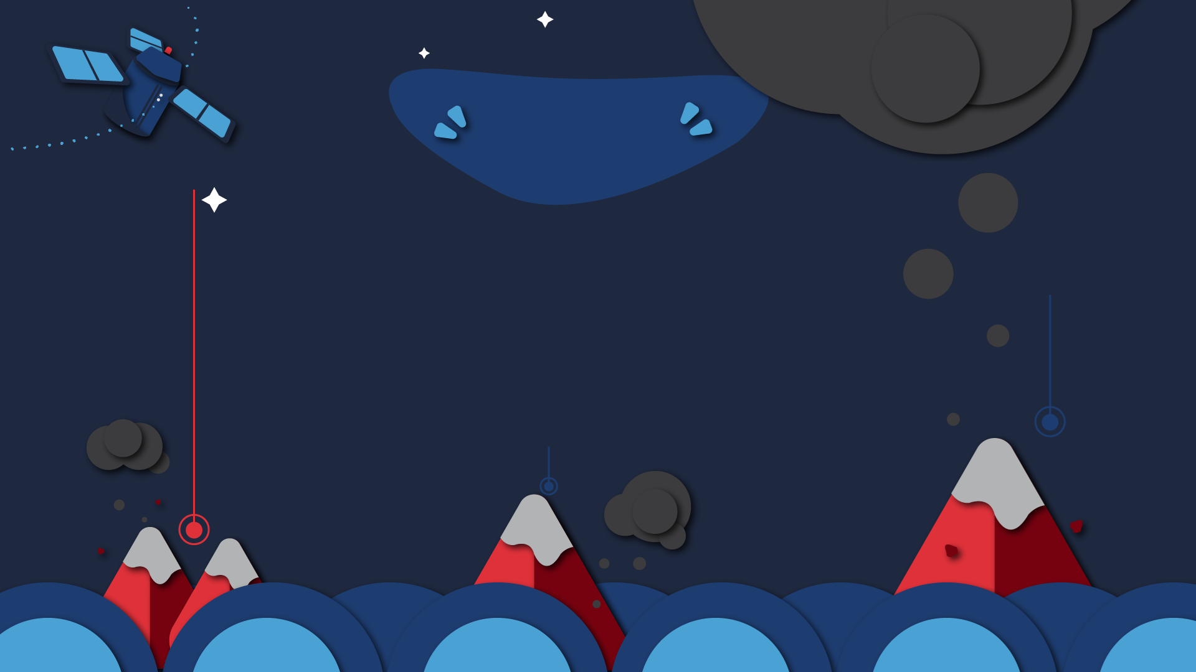


Chapter 3
Application of Satellite Data
Center of Excellence in AI and Emerging Technology

Slide 2



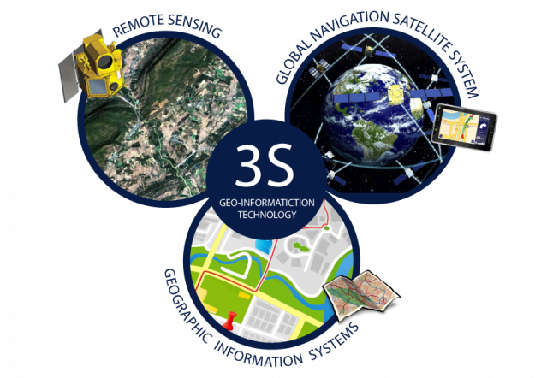
Geo-Informatics
http://oldweb.most.go.th/main/index.php/media-library/ground-to-sky/5963--geo-information-technology.html
Center of Excellence in AI and Emerging Technology

Slide 3

Remote Sensing
It is a branch of science and technology that Used to indicate, classify or analyze the characteristics of various objects without direct contact but uses the properties of electromagnetic waves as a medium to acquire information in 3 ways:
• Wave range (spectral)
• Spatial shape
• Changes over time (temporal) of things on the earth's surface.
Center of Excellence in AI and Emerging Technology

Slide 4
Principle of remote sensing
Consists of 2 processes as follows:
• Data Acquisition starts from electromagnetic energy from an energy source such as the sun moving through the Earth's atmosphere, interacting with objects on the earth's surface and travel into the measuring device/recording device attached to the orbiting probe (Platform) that through the recorded data of objects on the earth's surface are converted into signals as a receiving station and produce data in the form of inferential data (Analog Data) and numerical data (Digital Data) for analysis.
There are 2 methods of data analysis:
• Visual analysis that gives qualitative data results cannot be measured as a definitely number.
• Computer analysis (Digital Analysis) that gives quantitative data that can display the analysis results as a numerical value.
Center of Excellence in AI and Emerging Technology

Slide 5
Image of receiving and sending data
Center of Excellence in AI and Emerging Technology

Slide 6
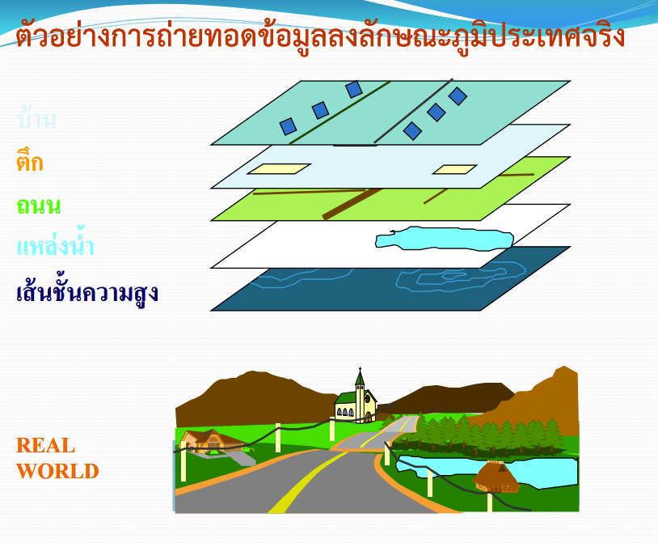
Geographic Information System
An example of transferring data to real topography
An information system that links areas with geographic coordinates and details of areas on the earth. Using a computer that consists of hardware and software for importing, storing, modifying, converting, analyzing data and displaying results in various formats such as maps, 3D images, statistics, percentage data tables. All of this helps in planning and making decisions with accuracy and precision.
Geographic information systems can store various types of data in layers (Layers), where those data layers overlap to show the actual area.
Houses
Building
Street
Water source
Contour lines

Slide 7
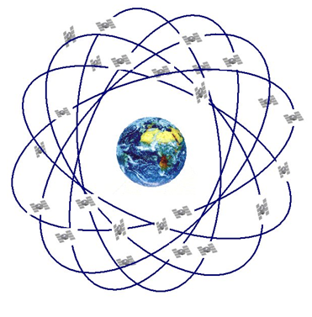
Global Positioning System - GPS
The Global Positioning System (GPS) is a navigation system based on radio waves and codes sent by 24 NAVSTAR (NAVigation Satellite Timing and Ranging) satellites orbiting above the earth. It has been used to locate every point on the Earth's surface 24 hours a day for the past decade. GPS satellite surveying technology has developed rapidly and has become widely applied after opening 24 hours a day.
https://sites.google.com/site/nasinuanpitthayasan/home/knowledge/geoinformatics

